Slide 1

Presentation on Cascading Style Sheets (CSS)
Prepared by – Rojan Dhungel (L4CG6)
Web Technologies

Slide 2
What is CSS in HTML and why is it used for?
CSS describes how HTML elements are to be displayed on screen, paper, or in other media. CSS saves a lot of work. It can control the layout of multiple web pages all at once. External stylesheets are stored in CSS files.

Slide 3
Visual Representation of Selector, Property and Value
selector{
property:
value;
}

Slide 4

CSS Selectors
CSS Universal Selector - The universal selector is a special type selector and can therefore be namespaced when using @namespace.
CSS Attribute Selector - The CSS attribute selector matches elements based on the presence or value of a given attribute.
CSS Id Selector - The CSS ID selector matches an element based on the value of the element's ID attribute.
CSS Class Selector - The CSS class selector matches elements based on the contents of their class elements.

Slide 5

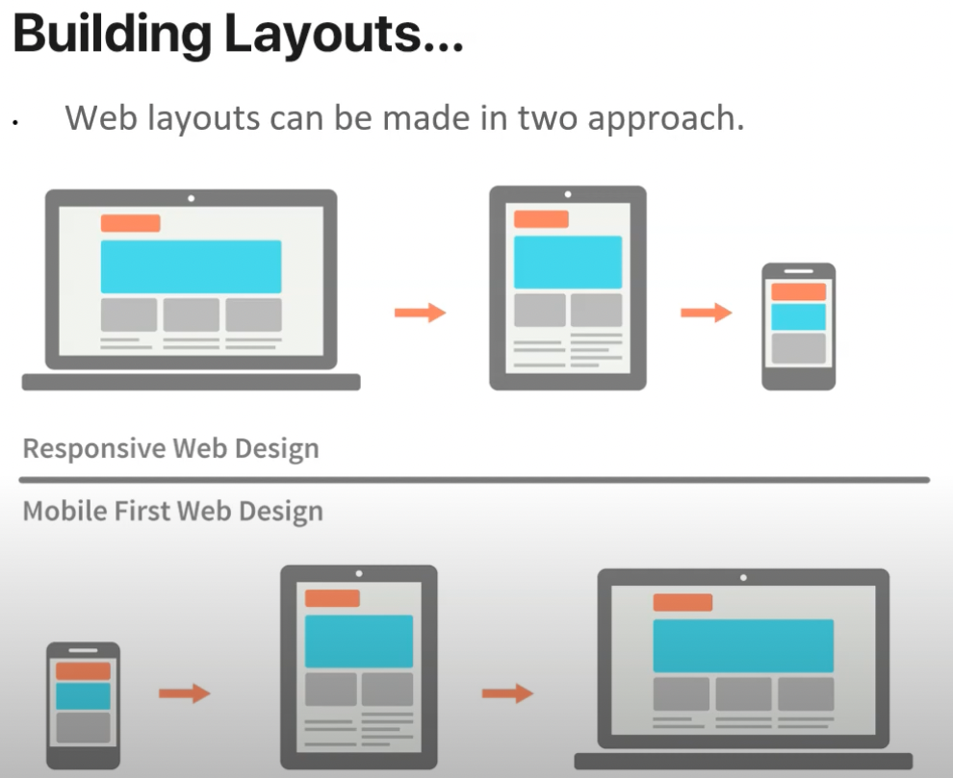
Layout Designing
Float Property
Position Property
Display Property

Slide 6
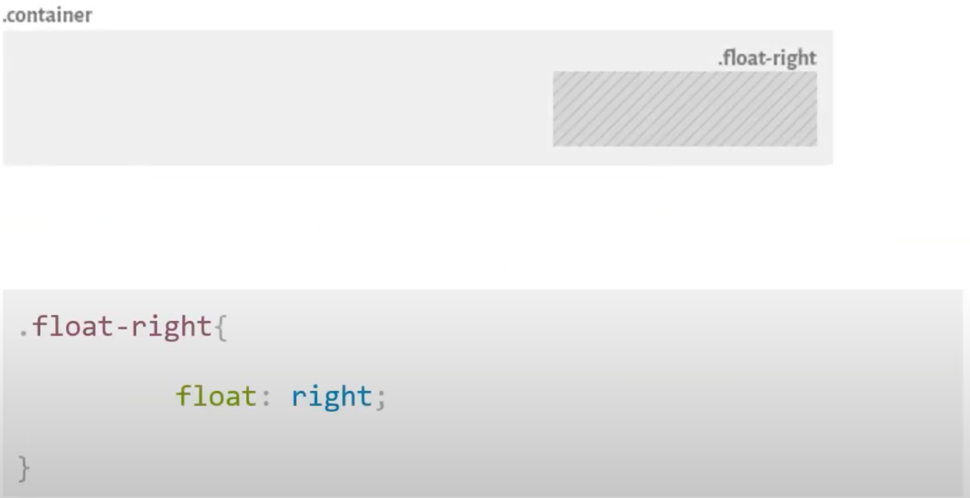
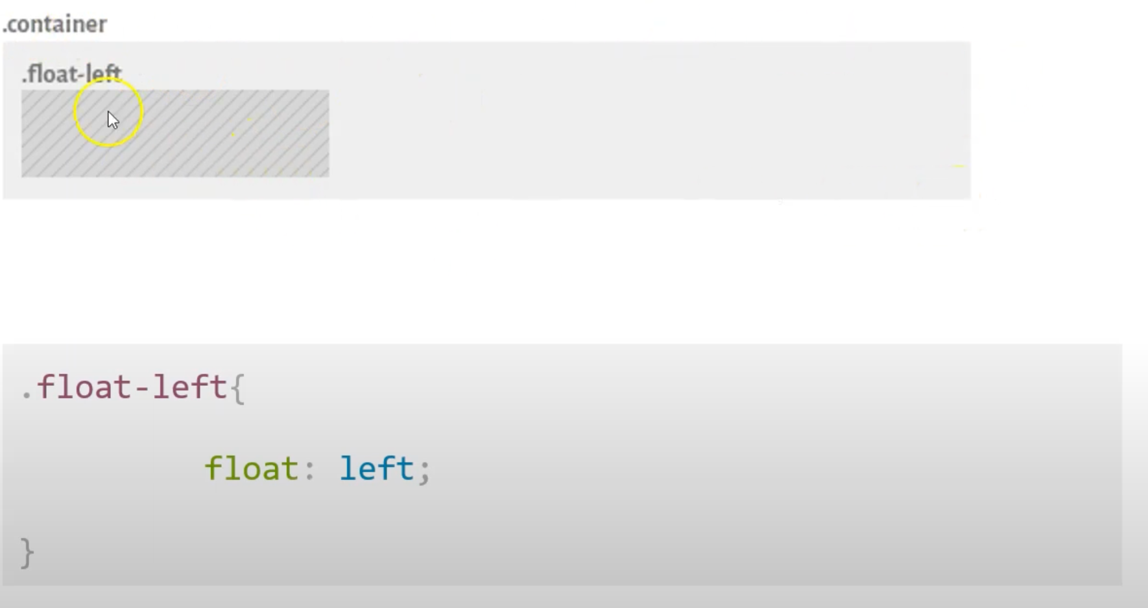
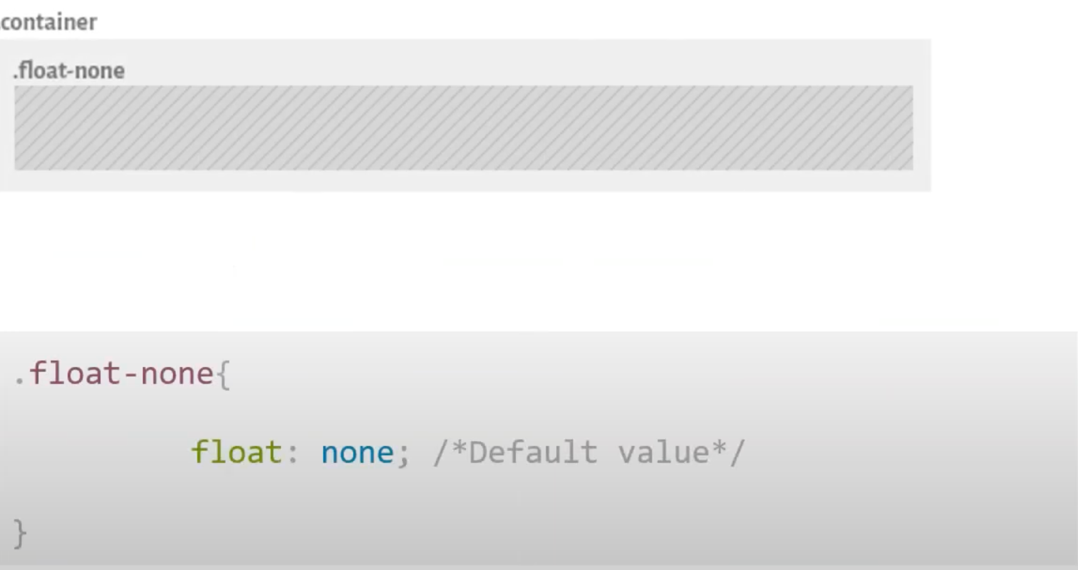
Float Property
The float CSS property places an element on the left or right side of its container, allowing text and inline elements to wrap around it. The element is removed from the normal flow of the page, though still remaining a part of the flow (in contrast to absolute positioning).

Slide 7
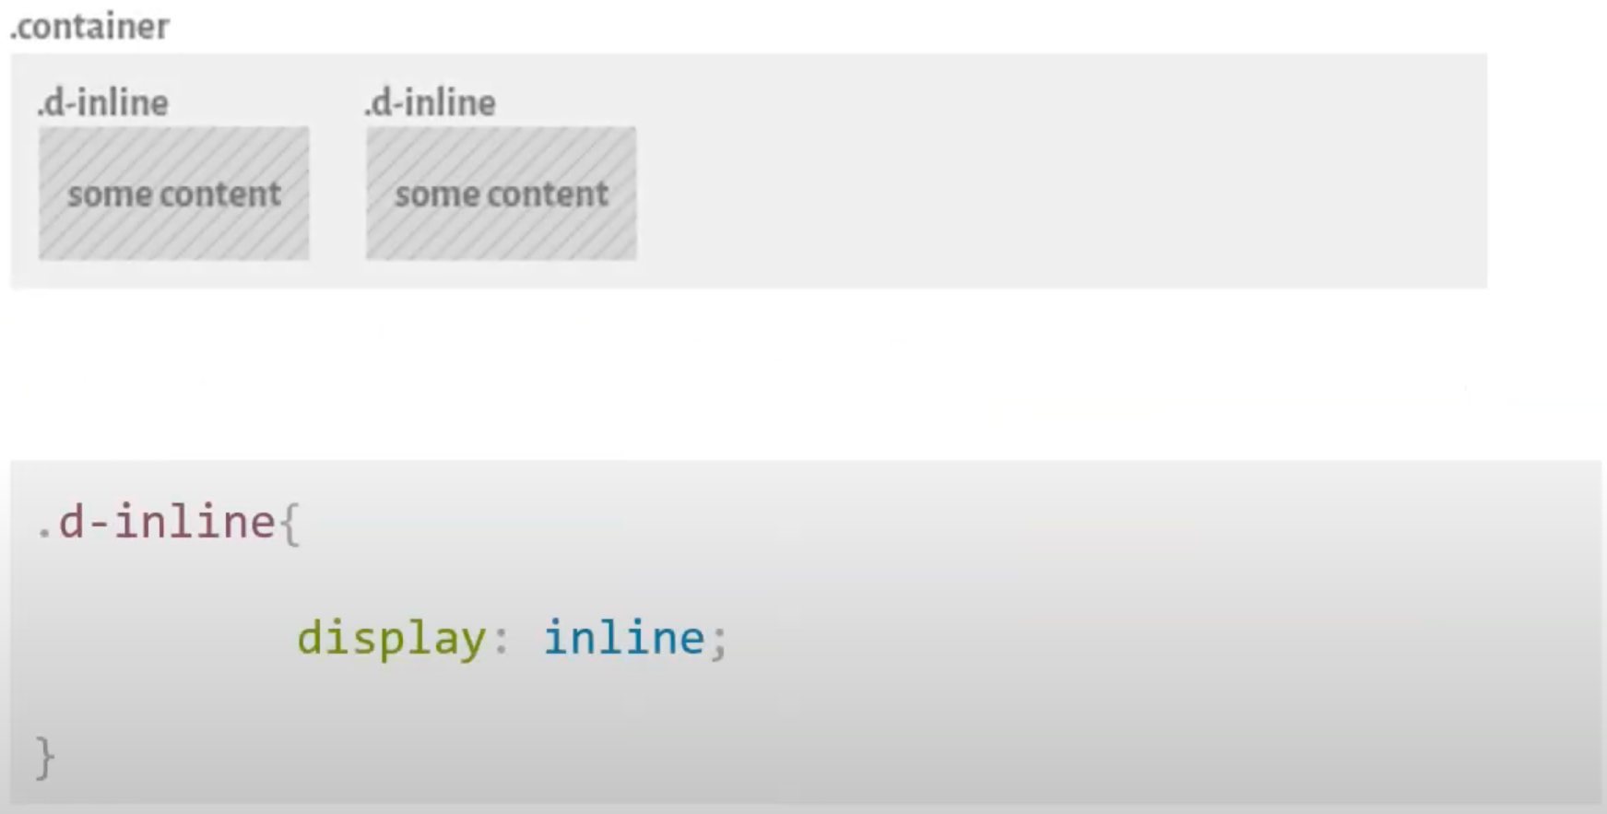
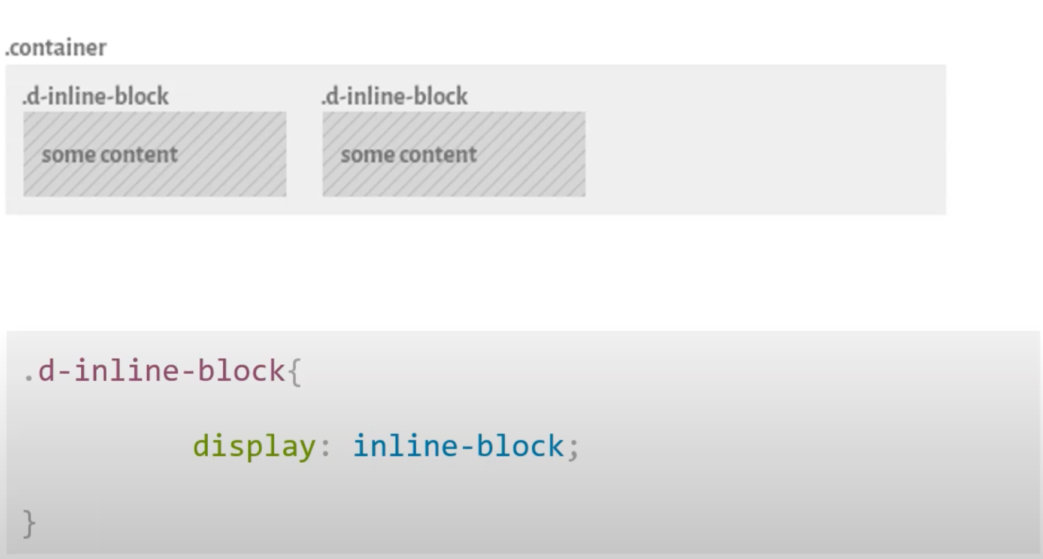
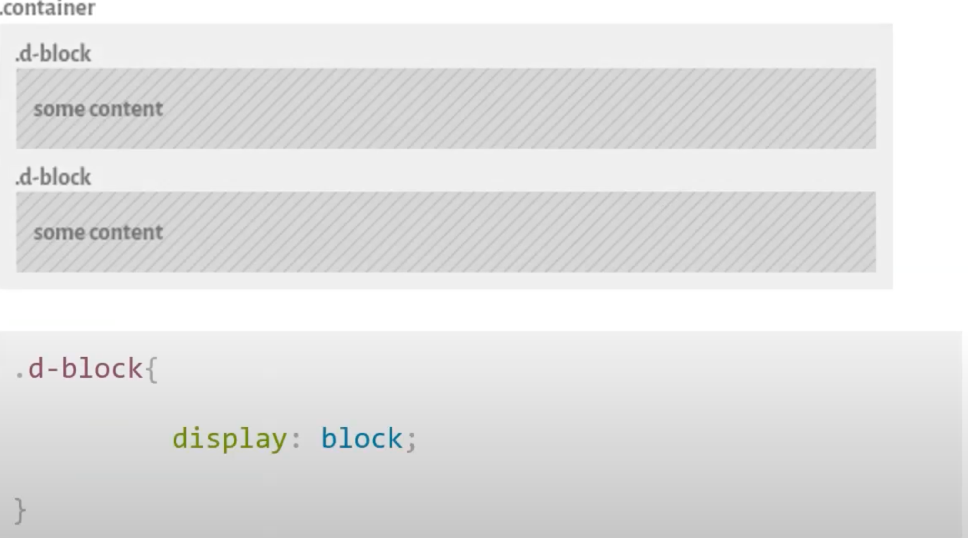
Display Property
The display CSS property sets whether an element is treated as a block or inline element and the layout used for its children, such as flow layout, grid or flex. Formally, the display property sets an element's inner and outer display types.

Slide 8
Positional Property
The position CSS property sets how an element is positioned in a document. The top, right, bottom, and left properties determine the final location of positioned elements

Slide 9
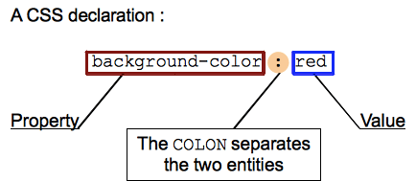
Value
It is required to put the desired requirement.

Slide 10
CSS Box Model
Margin - Clears the area outside the border.
Border - The border that goes around padding and content.
Padding - Clears an around the context. The padding is transparent.
Content - The content of the box, where text, images, etc. appear

Slide 11
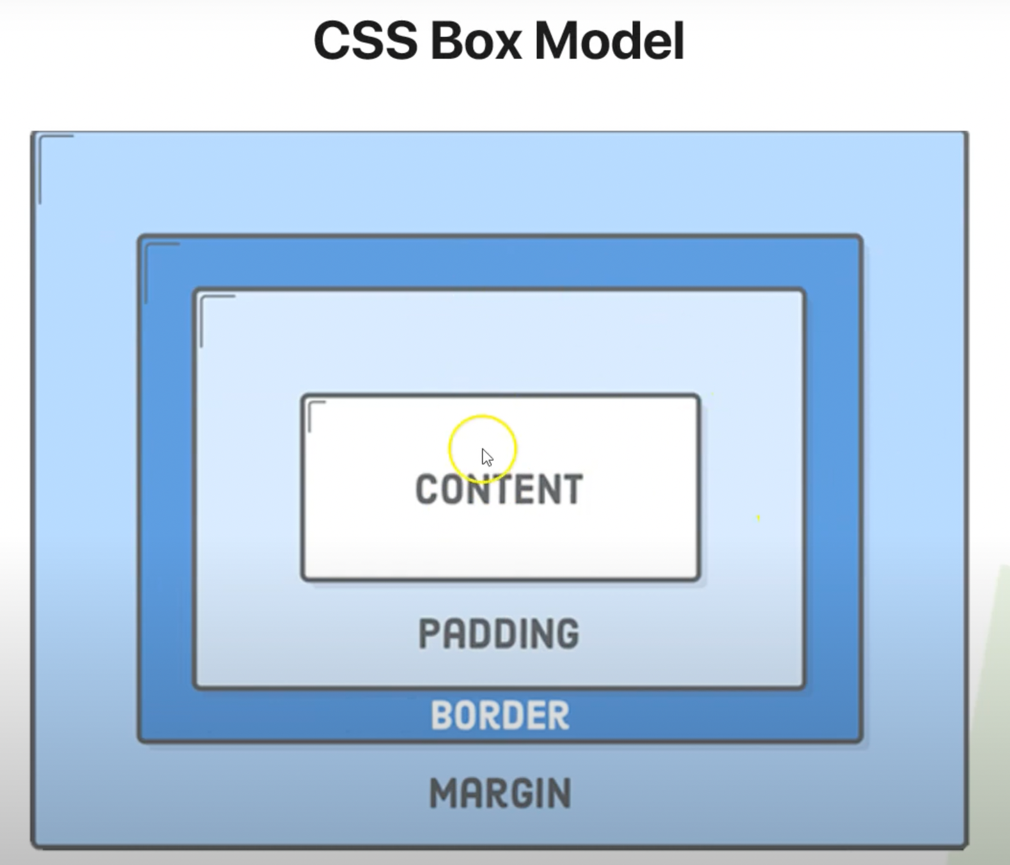
Box Model Figure
Figure :

Slide 12
References
https://developer.mozilla.org/en-US/docs/Web/CSS/class_selectors
https://developer.mozilla.org/en-US/docs/Web/CSS/Universal_selectors
https://developer.mozilla.org/en-US/docs/Web/CSS/Attribute_selectors
https://developer.mozilla.org/en-US/docs/Web/CSS/Element_selectors
https://www.youtube.com/watch?v=BaXrFsVHgtk
https://developer.mozilla.org/en-US/docs/Web/CSS/position

